Slide 1
Deep Learning
Avanade ASG Data Science Bootcamp

Slide 2
Deep Learning Introduction
Definition, History, Use Cases, Example Applications

Slide 3
What is Deep Learning?
Deep learning is a subfield of Machine Learning that comprises learning from data with deep artificial neural networks.
Artificial neural networks are inspired by the human brain, and they are the most promising shot to general artificial intelligence as of today (although we are still far away from general artificial intelligence).
The state-of-the-art models in many domains / for many data structures are deep-learning-based:
For sequence data / natural language processing: GPT-3, BERT, …
For grid data / computer vision: ViT, StyleGAN-XL, …
For graph data: GCN, GAT, …
Not for tabular data though, where XGBoost still reigns!
Artificial Intelligence
Machine Learning
Deep Learning

Slide 4
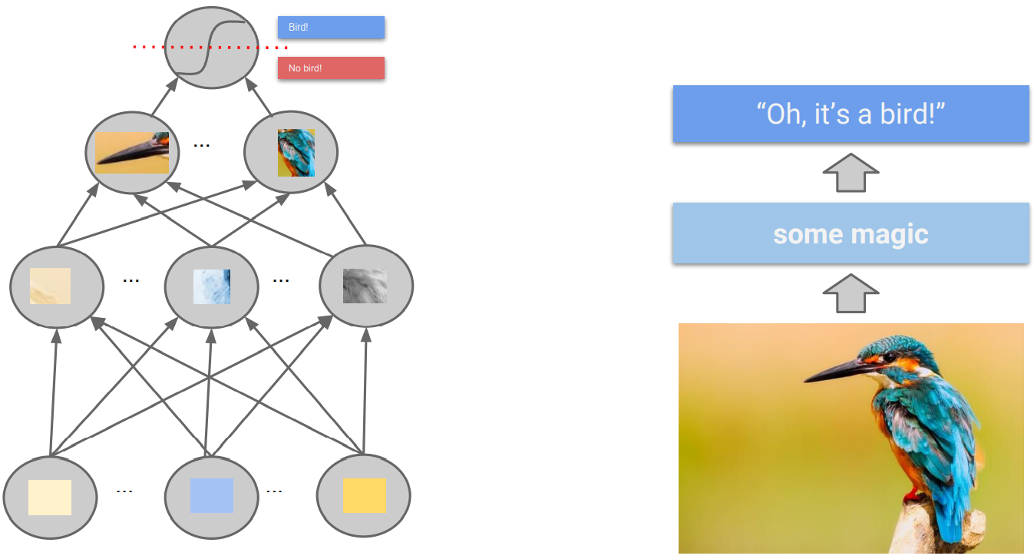
(Artificial) Neural Network Intuition
“Machine learning algorithms, inspired by the brain, based on learning multiple levels of representation / abstraction.” (Yoshua Bengio)

Slide 5
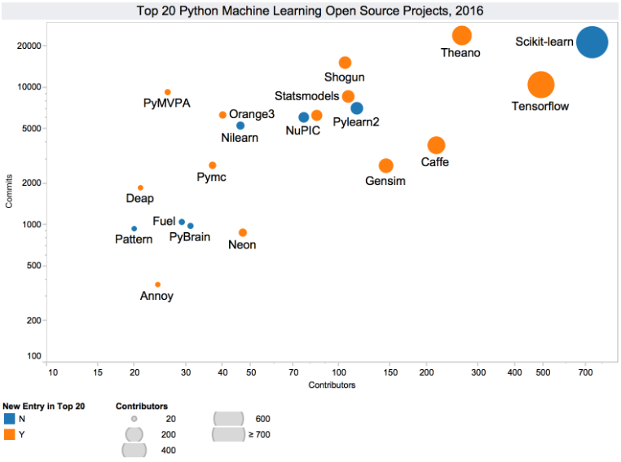
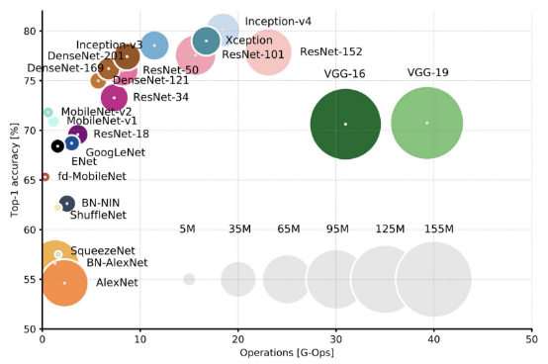
History & Present of (Deep) Neural Networks
Deep learning is not new. Artificial neural networks have been first proposed in 1943. Deep neural networks, i.e. artificial neural networks with multiple hidden layers have been around since the 1970s. They were semi successful back then.
But deep learning has taken off since the start of this millennium. Why is that?
Specialized, powerful hardware (GPUs, TPUs) allows training of huge neural networks to push the state-of-the-art performance on difficult problems.
Large amount of data is available because of increasing digitalization: Web 2.0, IoT, modern ERP & CRM systems etc.
Special network architectures have been designed by researchers for image / text / graph data.
Better optimization and regularization strategies have been developed.
Distributed frameworks allow for parallel training.
Open-source culture in the AI community drives further progress.
Cloud platforms like Azure, AWS, GCP make training of large-scale deep learning models more accessible.

Slide 6
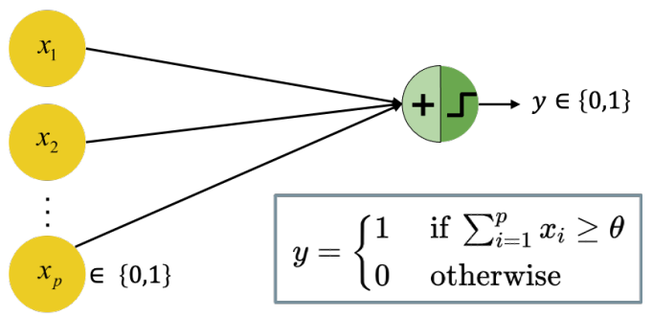
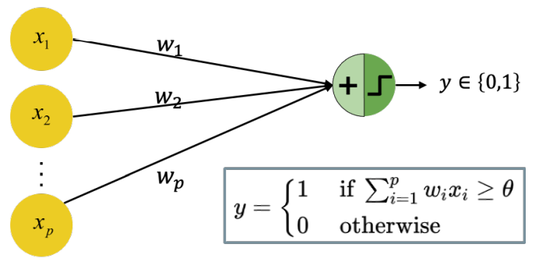
A Brief History: Starting from the Beginning
1943: the first artificial neuron, the “Threshold Logic Unit (TLU)”, was proposed by Warren McCulloch & Walter Pitts
The model is limited to binary inputs
It fires/outputs +1 if the input exceeds a certain threshold θ
The weights are not adjustable, so learning could only be achieved by changing the threshold θ
1957: the perceptron was invented by Frank Rosenblatt
The inputs are not restricted to be binary
The weights are adjustable and can be learned by learning algorithms
As for the TLU, the threshold is adjustable based on the classification result and decision boundaries are linear

Slide 7
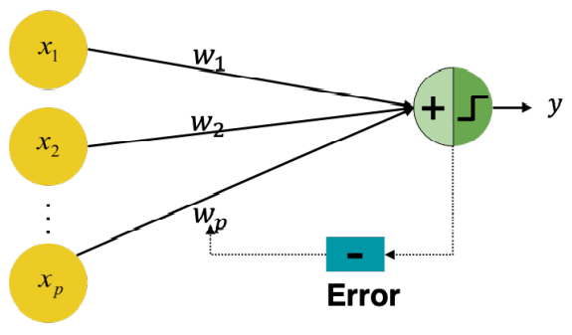
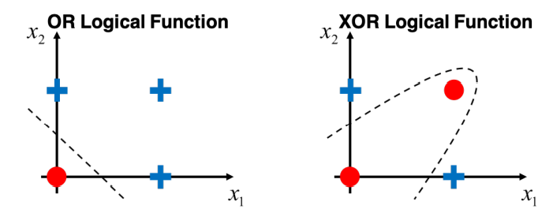
A Brief History: First AI Winter
1960: Adaptive Linear Neuron (ADALINE) was invented by Bernard Widrow & Ted Hoff; weights are now adjustable according to the weighted sum of input, yielding a numeric error instead of just misclassification.
1965: group method of data handling (also known as polynomial neural networks) by Alexey Ivakhnenko. The first learning algorithms for supervised deep feedforward multilayer perceptrons.
1969: the first “AI Winter” kicked in.
Marvin Minsky & Seymour Papert proved that a perceptron cannot solve the XOR-Problem (linear separability)
Less funding led to standstill in AI / DL research

Slide 8
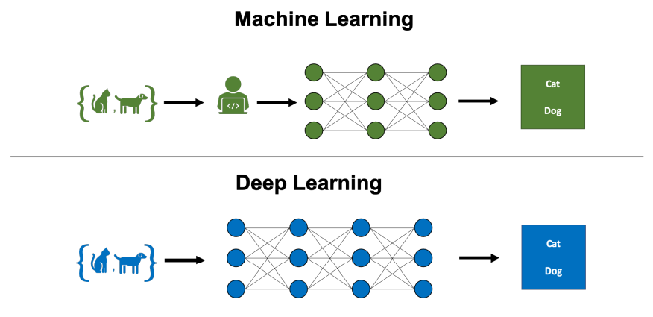
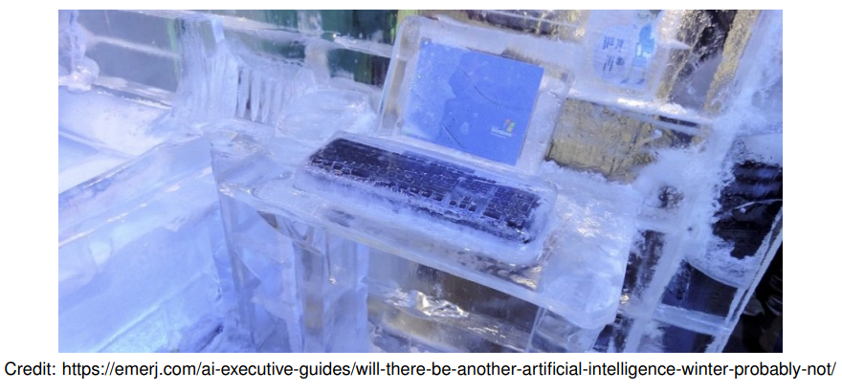
A Brief History: Second AI Winter
1985: Multilayer perceptron with backpropagation by David Rumelhart, Geoffrey Hinton, and Ronald Williams
Efficiently compute derivatives of composite functions
Backpropagation was developed already in 1970 by Linnainmaa
1985: the second “AI Winter” kicked in.
Overly optimistic expectations concerning potential of AI / DL
The phrase “AI” even reached a pseudoscience status
Kernel machines and graphical models both achieved good results on many important tasks
Some fundamental mathematical difficulties in modeling long sequences were identified.
2006: age of deep neural networks began
Geoffrey Hinton showed that a deep belief network could be efficiently trained using greedy layer-wise pretraining.
This wave of research popularized the use of the term deep learning to emphasize that researchers were now able to train deeper neural networks than had been possible before.
At this time, deep neural networks outperformed competing AI systems based on other ML technologies as well as hand-designed functionality.

Slide 9
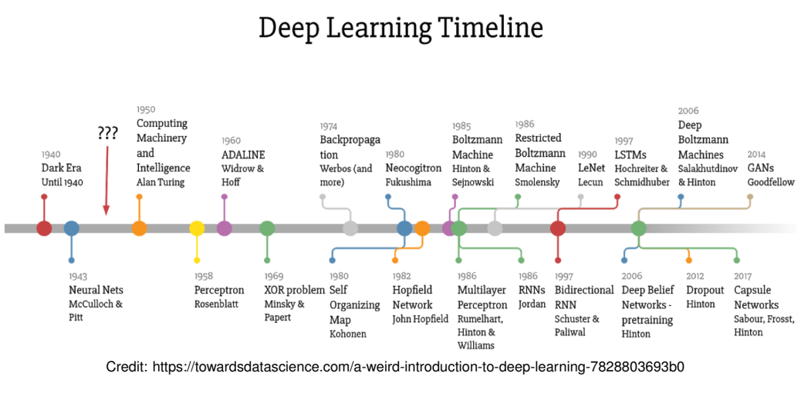
A Brief History: Timeline of Algorithms
2017: Transformers!!!

Slide 10
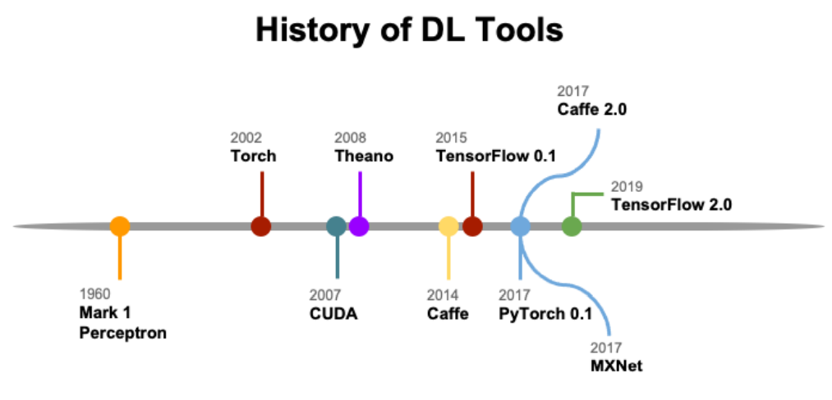
A Brief History: Timeline of Tools
2018: JAX

Slide 11
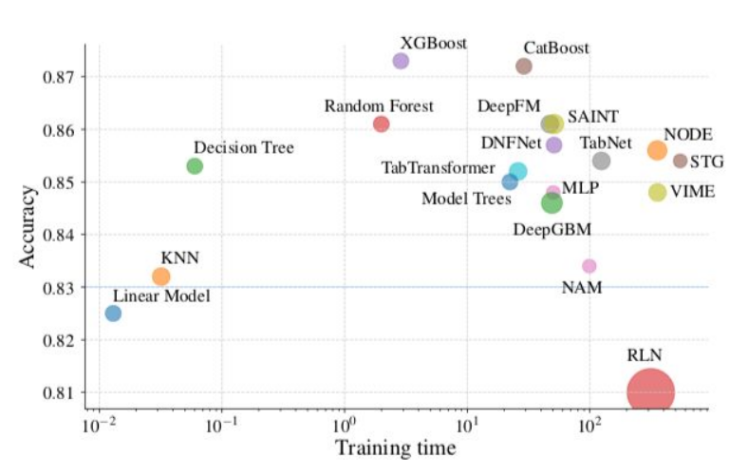
When is Deep Learning Useful? (1/3)
Deep learning can be extremely valuable if the data has these properties:
It is high dimensional.
Each single feature itself is not very informative but only a combination of them is.
Large amounts of training data are available.
For tabular data, deep learning is therefore rarely the correct model choice.
Without extensive tuning, models like random forests or gradient boosting will outperform deep learning most of the time.
Borisov, V. et al. Deep neural networks and tabular data: A survey. arXiv [cs.LG] (2021)
One exception is data with categorical features with many levels.

Slide 12
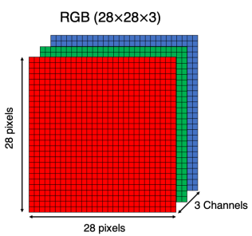
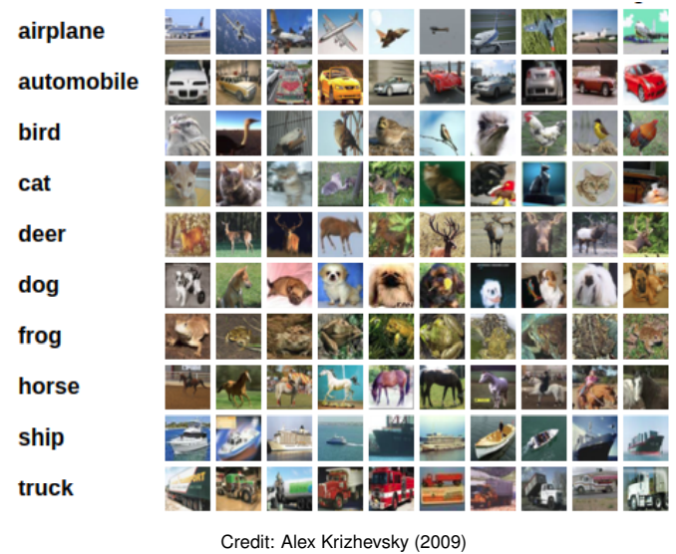
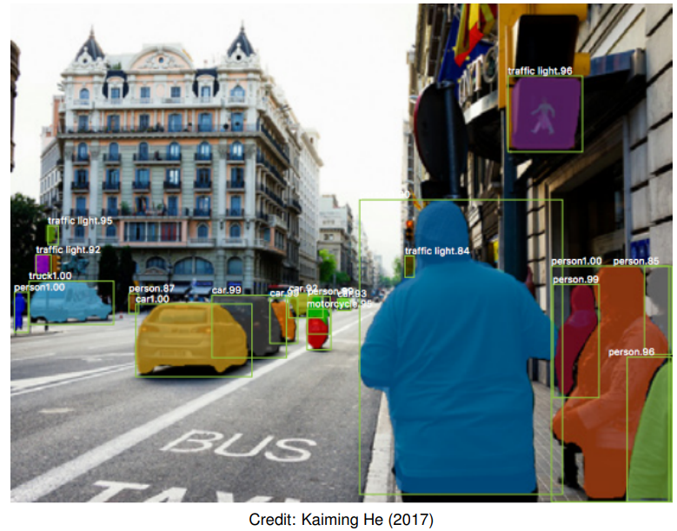
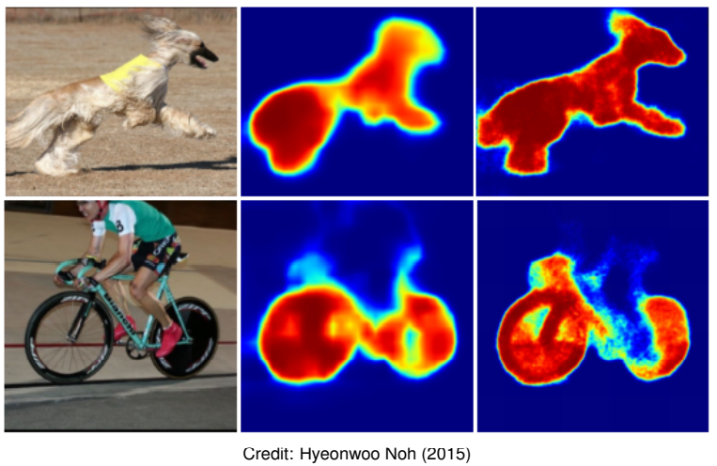
When is Deep Learning Useful? (2/3)
One promising use case for deep learning are tasks based on images as they are characterized by:
High dimensionality: a color image with 255 × 255 (3 Colors) pixels already has 195075 features.
Informativeness: a single pixel is not meaningful but only a combination of pixels is.
Training data: depending on the desired application, huge amounts of data are available.
Traditionally, Convolutional Neural Networks (CNNs) were the architecture of choice for tasks involving images. Now transformer-based architectures are taking off. Possible tasks include but are not limited to:
Image classification: predict a single label for each image
Object detection: generate bounding boxes for each instance
Instance segmentation: partition the image into segments

Slide 13
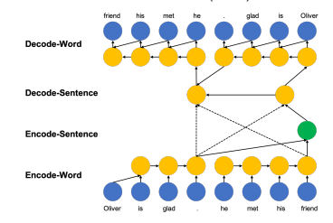
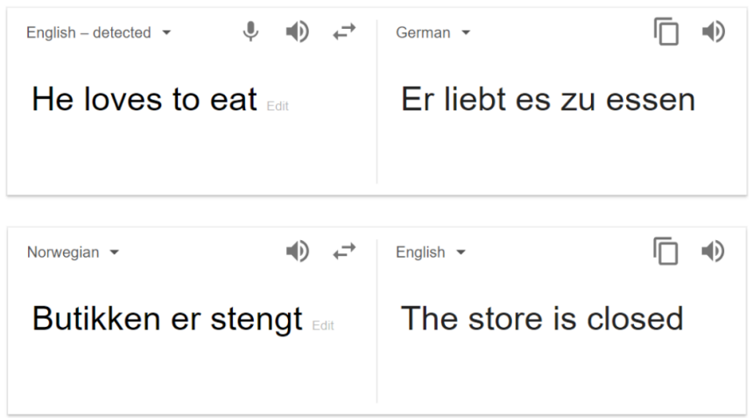
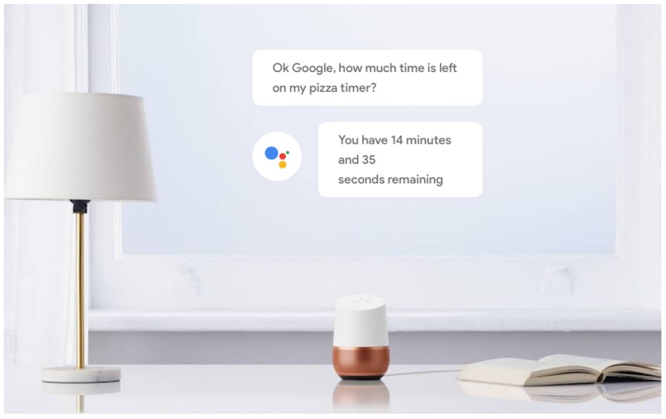

When is Deep Learning Useful? (3/3)
Another promising use case for deep learning are tasks based on text as it is characterized by:
High dimensionality: each word can be a single feature (300,000 words in German).
Informativeness: a single word does not provide much context.
Training data: huge amounts of text data available.
Traditionally, Recurrent Neural Networks (RNNs) and Long short-term memory (LSTM) were the architectures of choice for tasks involving text. Now transformer-based architectures are the unattainable state-of-the-art. Possible tasks include but are not limited to:
Sentiment analysis: systematically identify the emotional and subjective information in texts
Machine translation: predict likelihood of a sequence of words, typically modeling entire sentences in a single integrated model
Speech recognition & generation: Extract features from audio data for downstream tasks, e.g. to classify emotions in speech

Slide 14
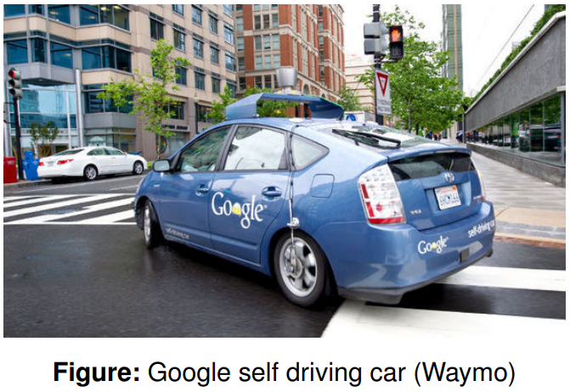
Deep Learning Applications: Autonomous Driving
Google’s development of self-driving technology began on January 17, 2009, at the company’s secretive X lab.
By January 2020, 20 million miles of self-driving on public roads had been completed by Waymo.

Slide 15
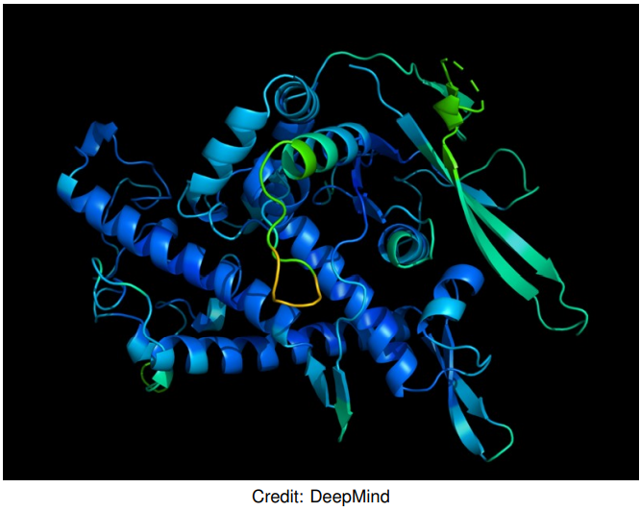
Deep Learning Applications: AlphaFold
AlphaFold is a deep learning system, developed by Google DeepMind, for determining a protein’s 3D shape from its amino-acid sequence.
In 2018 and 2020, AlphaFold placed first in the overall rankings of the Critical Assessment of Techniques for Protein Structure Prediction (CASP).

Slide 16
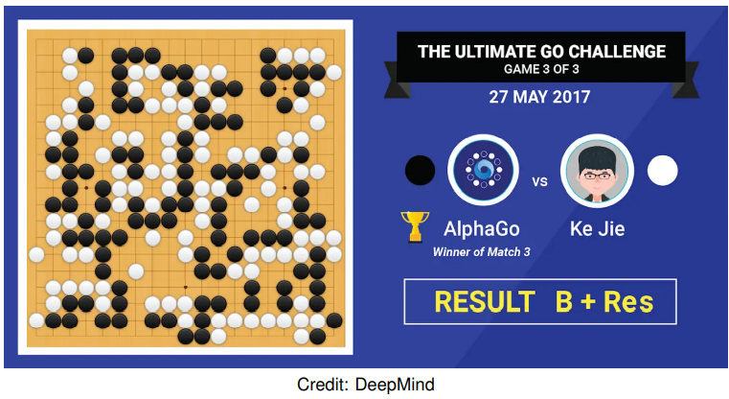
Deep Learning Applications: AlphaGo
AlphaGo, originally developed by DeepMind, is a deep learning system that plays the board game Go. In 2017, the Master version of AlphaGo beat Ke Jie, the number one ranked player in the world at the time.
While there are several extensions to AlphaGo (e.g., Master AlphaGo, AlphaGo Zero, AlphaZero, and MuZero), the main idea is the same: search for optimal moves based on knowledge acquired by machine learning.

Slide 17

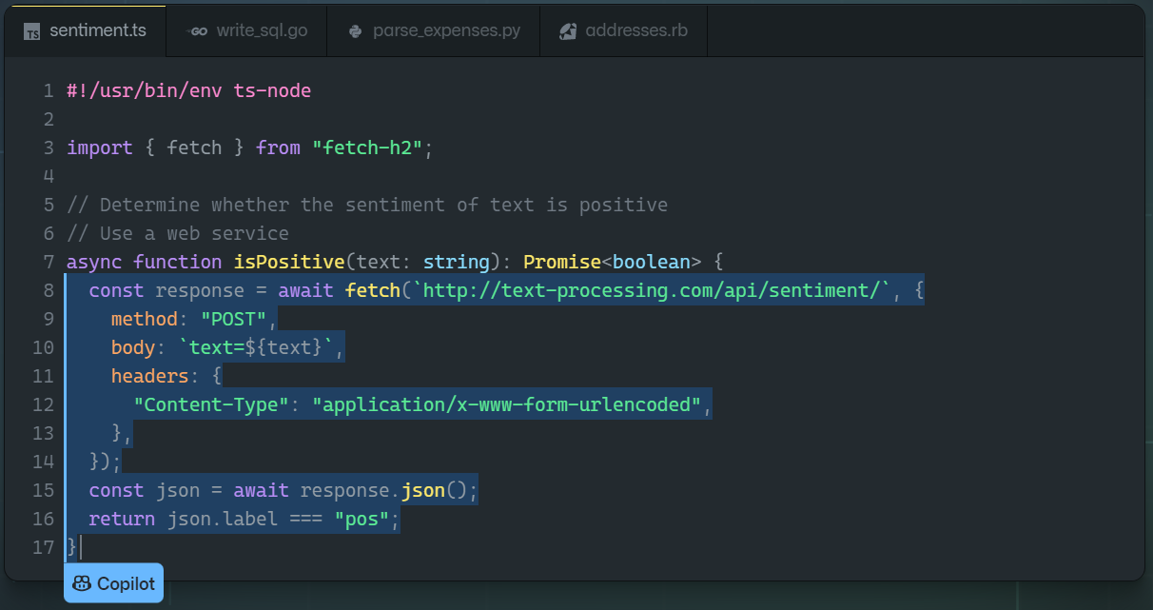
Deep Learning Applications: GitHub Copilot
GitHub Copilot is a code assistant powered by Codex, a new AI system created by OpenAI. GitHub Copilot uses the context you’ve provided and synthesizes code to match.
Find more information here: GitHub Copilot · Your AI pair programmer.

Slide 18
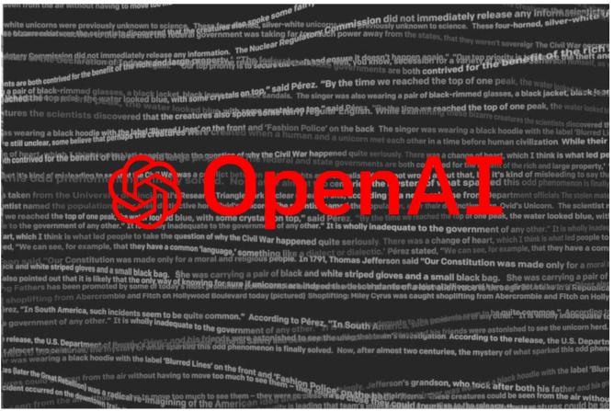
Deep Learning Applications: GPT-3
Generative Pre-trained Transformer 3 (GPT-3) is the third generation of the GPT model, introduced by OpenAI in May 2020, to produce human-like text.
There are 175 billion parameters to be learned by the algorithm, but the quality of the generated text is so high that it is hardly possible to distinguish it from a human-written text.

Slide 19

Deep Learning Applications: DALL-E 2
Dall-E-2 is a new AI system from January 2021 that can create realistic images and art from a description in natural language.
Find more information here: DALL·E 2 (openai.com).

Slide 20
Neural Network Basics
Fully-Connected NNs, Multilayer NNs, Deep NNs, Activation Functions, Forward Pass

Slide 21
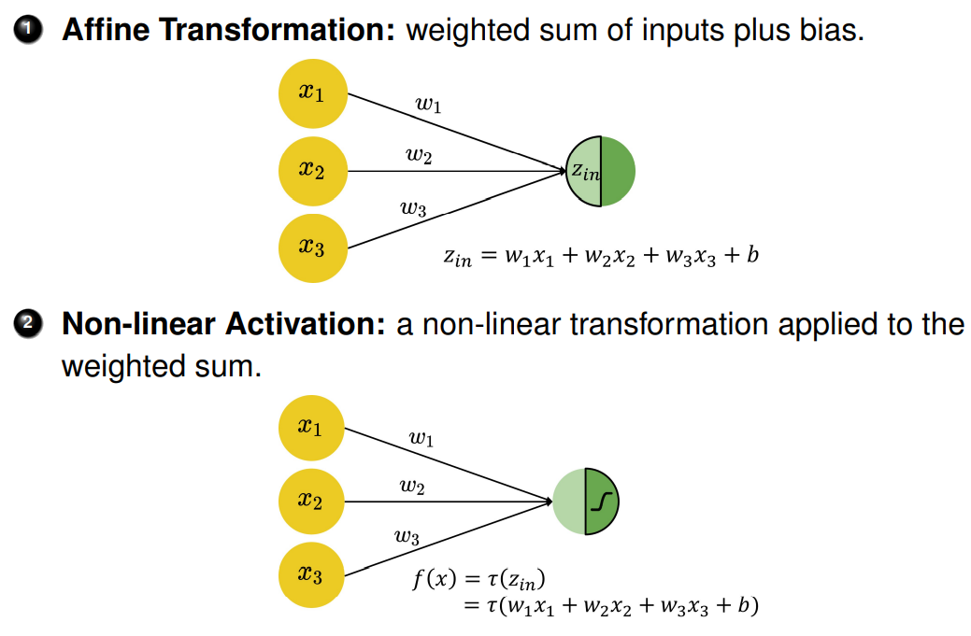
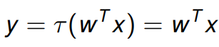
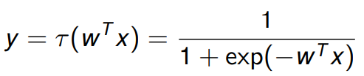
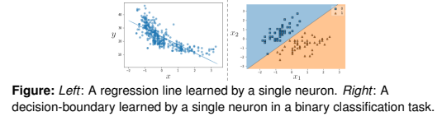
Fully-Connected Neural Networks
The basic computational unit for neural networks is the perceptron. It is a weighted sum of input values plus bias term, transformed by a non-linear activation function, resulting in an output value (→ single neuron).
A suitable choice of the activation function τ leads to known functions f(x).
The identity function gives us the simple linear regression:
The logistic function (sigmoid function) gives us the logistic regression:
Notes:
Single-layer network with sigmoid activation function could approximate any continuous function infinitely closely (Universal Approximation Theorem)

Slide 22
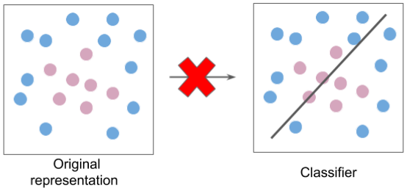
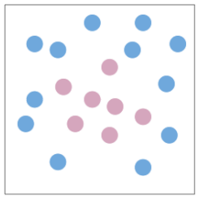
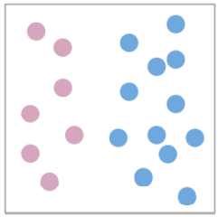
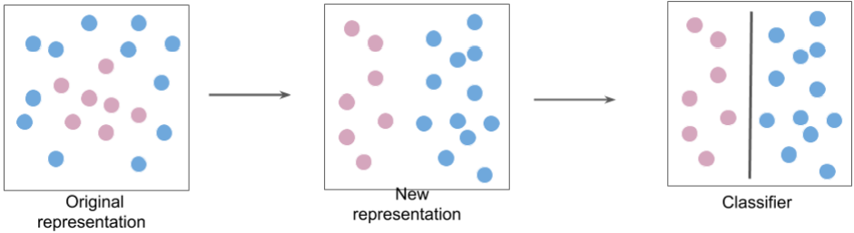
Multilayer Neural Networks: Motivation (1/2)
1) A single neuron is restricted to learning only linear decision boundaries. Thus, its performance on the following dataset is quite poor:
2) However, the neuron can easily separate the classes if the original features are transformed (e.g. from Cartesian to polar coordinates):
3) Instead of classifying the data in the original representation:
4) We classify it in a new feature space:
Individual neurons are used as building blocks to build more complicated architectures that transform the feature space. This allows us to efficiently learn functions that are more common in our universe.

Slide 23
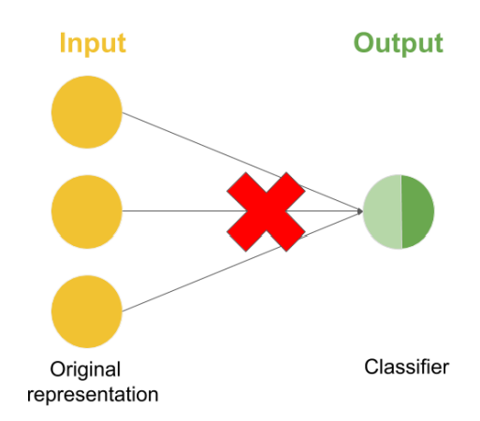
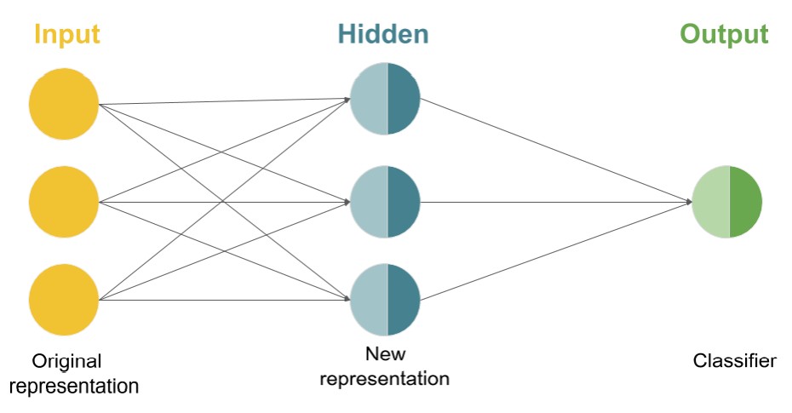
Multilayer Neural Networks: Motivation (2/2)
So instead of a single neuron, we use more complex networks.
Note: a multilayer neural network is still “just” a mathematical function f(x) that maps inputs to outputs (no magic involved although admittedly it can feel like magic). But the function f(x) can be complex. It is defined through the neural network architecture.

Slide 24
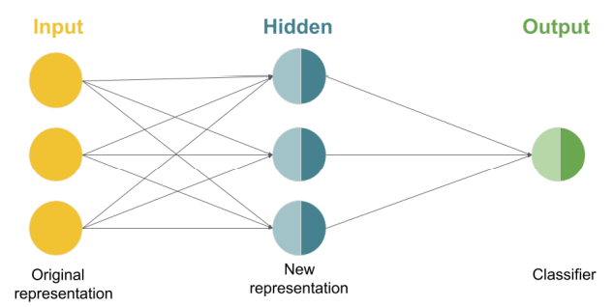
Multilayer Neural Networks
With multilayer neural networks we can approximate any continuous function -> Universal approximation theorem.
Fully-connected multilayer neural networks are also known as plain / vanilla neural networks or multilayer perceptrons and describe the simplest neural network architecture where all neurons from one layer are connected to the neurons of the next layer (this does not have to be the case for more complex architectures).
Notes:
. The following architecture with two neurons represents two logistic regressions using the same input features:
- Universal approximation theorem

Slide 25
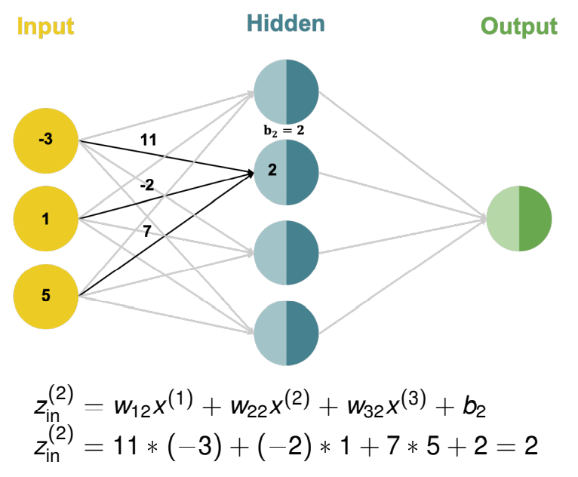
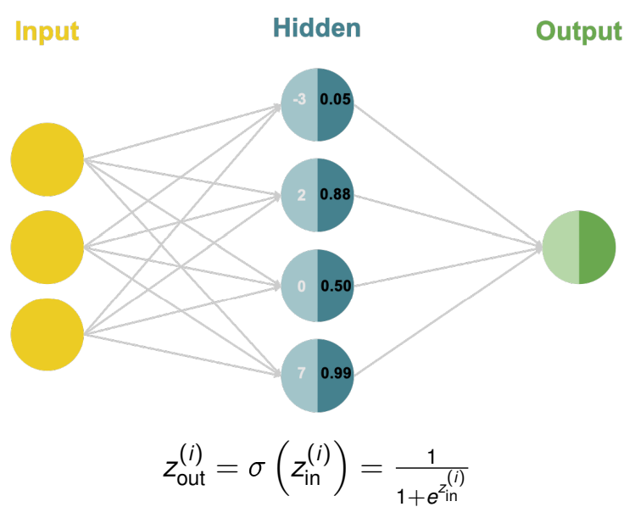
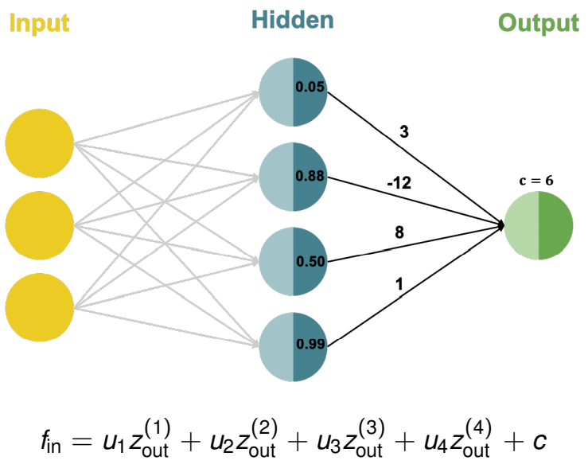
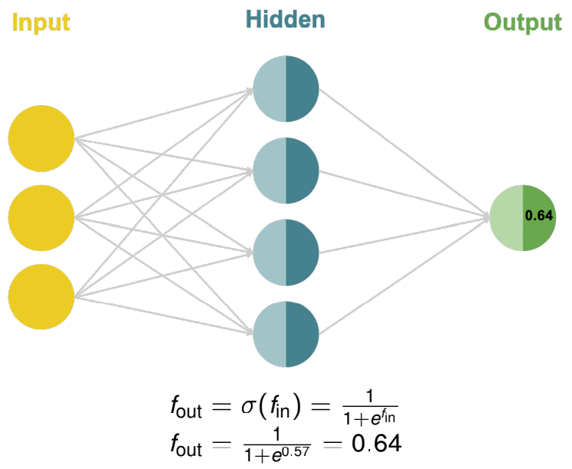
Multilayer Neural Networks: Forward Pass
Each neuron in the hidden layer performs an affine transformation on the inputs:
Each hidden neuron performs a non-linear activation transformation on the weighted sum:
The output neuron performs an affine transformation on its inputs:
The output neuron performs a non-linear activation transformation on the weighted sum:
Following the computation from left to right is called a forward pass. It is how Neural Networks make their predictions.

Slide 26
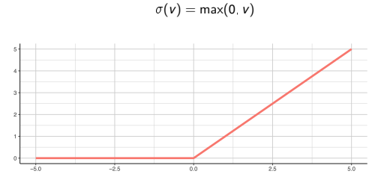
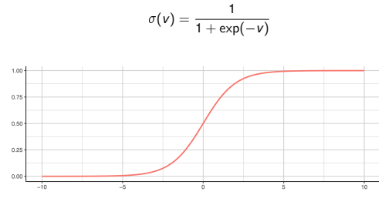
Activation Functions
If the hidden layer neurons do not have a non-linear activation, the network can only learn linear decision boundaries. Currently the most popular choice for an activation function is the ReLU (rectified linear unit). Another popular activation function is the sigmoid / logistic function, especially in the output layer to transform the values into probabilities
ReLU
Sigmoid

Slide 27
Representation Learning
It is critical to feed a classifier the “right” features in order for it to perform well.
Before deep learning took off, features for tasks like machine vision and speech recognition were “hand-designed” by domain experts. This step of the machine learning pipeline is called feature engineering.
The single biggest reason DL is so important is that it automates most feature engineering. This is called representation learning.

Slide 28
Deep Neural Networks
Why deep networks?
Multiple layers allow for the efficient extraction of more and more abstract representations. Each layer adds non-linearity to the model
Neural networks today can have hundreds of hidden layers. Historically, the training of such networks was challenging but it was made possible through various advances (some already mentioned before):
New activation functions (ReLU) that solved a problem known as “vanishing gradients”
New hardware that cut down training time (GPUs)
Order of magnitudes more data which benefits from the capacity of deep neural networks to learn complex functions. When dataset sizes are small, other models (such as SVMs) and techniques (such as feature engineering) often outperform deep neural networks
Novel architectures that are capable of handling complex (unstructured) data → e.g. CNNs for image / grid data, Transformers for text / sequence data.
Better optimization and regularization methods

Slide 29
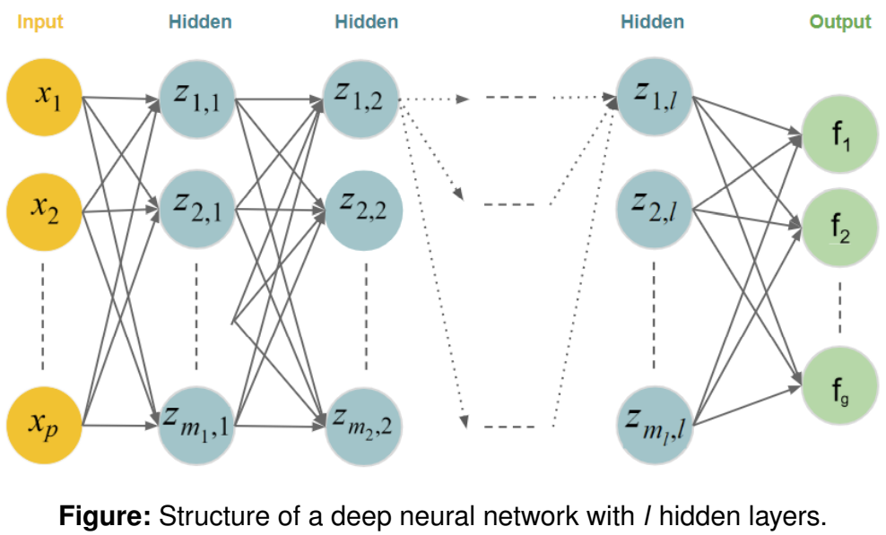
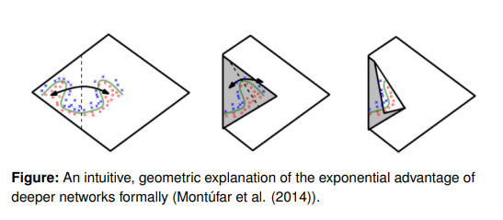
Deep Neural Networks
Note: state-of-the-art neural network architectures are much more sophisticated than the simple fully-connected architectures described here.
Deep Learning Engineer / Researcher is a full time profession and most of the people dedicating their career to it are really clever ;)

Slide 30
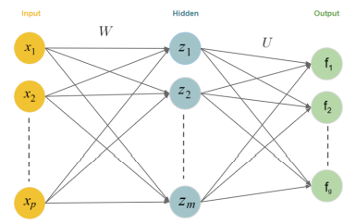
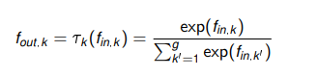
Multi-Class Classification
Add additional neurons to the output layer. Each neuron will represent a specific class
Now a softmax activation function will be used in the output layer instead of sigmoid

Slide 31
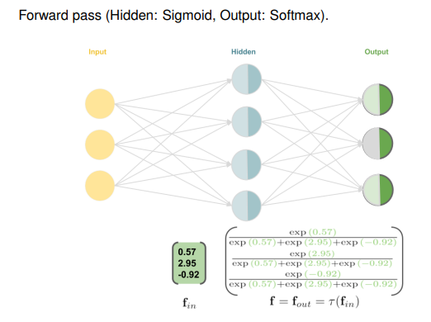
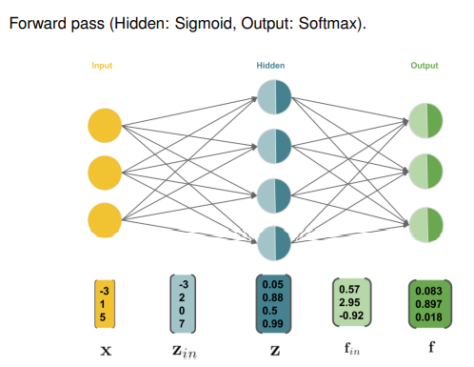
Softmax Activation Function

Slide 32
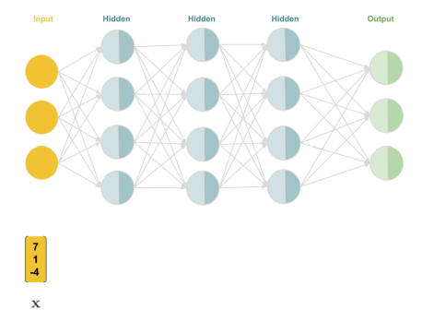
Deep Neural Network: Forward Pass Example

Slide 33
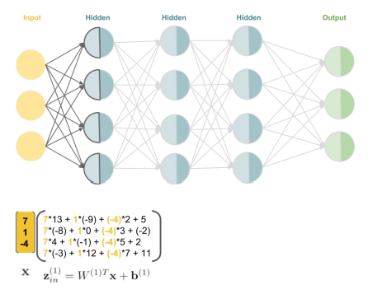
Deep Neural Network: Forward Pass Example

Slide 34
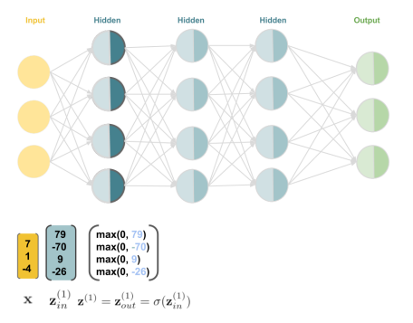
Deep Neural Network: Forward Pass Example

Slide 35

Deep Neural Network: Forward Pass Example

Slide 36

Deep Neural Network: Forward Pass Example

Slide 37

Deep Neural Network: Forward Pass Example

Slide 38

Deep Neural Network: Forward Pass Example

Slide 39

Deep Neural Network: Forward Pass Example

Slide 40

Deep Neural Network: Forward Pass Example

Slide 41

Deep Neural Network: Forward Pass Example

Slide 42

Deep Neural Network: Forward Pass Example

Slide 43
Neural Network Training
Loss Functions, Gradient Descent, Backpropagation

Slide 44




Training Neural Networks
Equal to traditional ML, we use empirical risk / cost minimization to minimize prediction losses over the training data to train neural networks (NN).
θ represents the weights (and biases) of the NN
For regression we use the L2 loss:
For binary classification, we use the cross-entropy loss
Now we need to use optimization algorithms to minimize the prediction losses over all training examples, using their labels

Slide 45


Gradient Descent
Gradient Descent is an iterative optimization algorithm that builds the basis for training NNs.
Calculate the gradients of the cost function and walk in the direction of steepest descent
“Standing” at a certain point θ [t] on our cost function, we locally improve by
α is called step size or learning rate.

Slide 46




Neural Network Training
Key question: how to pick the parameters w so that the mathematical function f(x) that the neural network represents is a useful mapping between inputs and outputs?
Answer: function optimization based on data
Introduce a loss function L (y, f(x)) that compares the network’s predictions f(x) to the ground truth y.
For regression, we typically use the L2 loss (rarely L1):
For binary classification, we typically apply the cross entropy loss (also known as bernoulli loss):
We minimize the sum of this loss function across our data points -> empirical risk minimization
This minimization is done with iterative algorithms like gradient descent
or a single neuron, in both cases, the loss function is convex and the global optimum can be found with an iterative algorithm like gradient descent

Slide 47


Gradient Descent & Optimality
Gradient Descent (GD) is a greedy algorithm: in every iteration, it makes locally optimal moves.
If the cost function is convex and differentiable, and its gradient is Lipschitz continuous, GD is guaranteed to converge to the global minimum for small enough step size / learning rate.
However, if the cost function has multiple local optima and/or saddle points, GD might only converge to a stationary point depending on the starting point

Slide 48
Gradient Descent & Optimality
We usually don’t find the global optimum but that is ok!
In Deep Learning, we are working with so high dimensional spaces (high number of parameters) that saddle points are really rare and local optima are good enough
Finding the global optimum might actually lead to overfitting. We are fitting the training data perfectly but what matters is generalization performance

Slide 49


Learning Rate
The learning rate α plays a key role in the convergence of the algorithm
If it is too small, the training process may converge very slowly
If it is too large, the training process may not converge, because it jumps around the optimum

Slide 50
Weight Initialization
Weights (and biases) of an NN must be initialized in GD.
We somehow must "break symmetry" – which would happen in full-0-initialization. If two neurons (with the same activation) are connected to the same inputs and have the same initial weights, then both neurons will have the same gradient update and learn the same features
Weights are typically drawn from a uniform a Gaussian distribution (both centered at 0 with a small variance).
Two common initialization strategies are ’Glorot initialization’ and ’He initialization’ which tune the variance of these distributions based on the topology of the network

Slide 51


Stochastic Gradient Descent
GD for Empirial risk minimization:
Using the entire training set in GD to is called batch or deterministic or offline training. This can be computationally costly or impossible, if data does not fit into memory.
Idea: Instead of letting the sum run over the whole dataset, use small stochastic subsets (minibatches), or only a single x (i) .
Idea: Instead of letting the sum run over the whole dataset, use small stochastic subsets (minibatches), or only a single x (i) .
We have a stochastic, noisy version of the batch GD. In practice, we use some tricks on top of SGD to make the optimization more efficient

Slide 52

How to calculate gradients?
Chain rule: Compute derivatives of the composition of two or more functions
If y = g(x) and z = f(y), the chain rule yields:

Slide 53


Computational Graphs
Computational graphs are nested expressions, visualized as graphs
Each node is a variable, either an input or derived
To compute the derivative of ∂z ∂w we need to recursively apply the chain rule. That is

Slide 54

Computational Graphs Neural Net
A neural network can be seen as a computational graph. . φ is the weighted sum and σ and τ are the activations.
Note: In contrast to the top figure, the arrows in the computational graph below merely indicate dependence, not weights. Optimization

Slide 55

Backpropagation (Backward pass): Basic Idea
We would like to run ERM by GD on:
Backprop training of NNs runs in 2 alternating steps, for one x:
1) Forward pass: Inputs flow through the model to outputs. We then compute the loss of the training example (as seen before)
2) Backward pass: Loss flows backwards to update weights so error is reduced

Slide 56

Full Training Example with an XOR Neural Network

Slide 57

Forward Pass

Slide 58

Forward Pass

Slide 59

Forward Pass

Slide 60

Forward Pass

Slide 61

Backward Pass

Slide 62

Backward Pass

Slide 63

Backward Pass

Slide 64

Backward Pass

Slide 65

Backward Pass

Slide 66

Backward Pass

Slide 67

Backward Pass

Slide 68

Backward Pass

Slide 69

Backward Pass

Slide 70

Backward Pass

Slide 71

Results
This was one training iteration, we have to do thousands to get optimized weights.
Luckily, this is the big advantage of deep learning frameworks. They have implemented something called autodiff, which automatically calculates gradients for us given a computational graph.

Slide 72
Modern Neural Network Architectures
Convolutional Neural Networks & Transformers

Slide 73

Convolutional Neural Networks: A First Glimpse
Convolutional Neural Networks (CNNs, or ConvNets) are a powerful family of neural network architectures in which the connectivity pattern between neurons resembles the organization of the mammal visual cortex.
Basic idea: a CNN automatically extracts visual, or, more generally, spatial features from the input data such that it is able to make the optimal prediction based on the extracted features.

Slide 74

Convolutional Neural Networks – A First Glimpse
Input layer takes input data (e.g. image, audio).
Convolution layers extract feature maps from the previous layers.
Pooling layers reduce the dimensionality of feature maps and filter meaningful features.

Slide 75
Transformers – A First Glimpse
“Novel” dominating deep learning architecture. Originally designed for sequence-to-sequence tasks (in particular machine translation)
Transformer: Vaswani, A. et al. Attention Is All You Need. arXiv [cs.CL] (2017)
Large-scale state-of-the-art NLP and computer vision models were possible thanks to Transformers and self-attention combined with transfer learning and unsupervised pre-training
BERT: Devlin, J., Chang, M.-W., Lee, K. & Toutanova, K. BERT: Pre-training of Deep Bidirectional Transformers for Language Understanding. arXiv [cs.CL] (2018)
GPT-2: Radford, A. et al. Language models are unsupervised multitask learners. OpenAI blog 1, 9 (2019)
GPT-3: Brown, T. et al. Language Models are Few-Shot Learners. Adv. Neural Inf. Process. Syst. 33, 1877–1901 (2020)

Slide 76
Deep Learning Lab
Deep Learning with PyTorch & Hugging Face Transformers

Slide 77
Deep Learning Resources
Deeplearning.ai Deep Learning Specialization
Fast.ai Practical Deep Learning for Coders Course
Yann LeCun’s Deep Learning Course
Ian Goodfellow’s Deep Learning Book
Deep Learning with PyTorch Youtube Course
Hugging Face Transformers Course
Notes:
Clusters are set up, configured, and fine-tuned to ensure reliability and performance without the need for monitoring.

